Slide 1
Motion Compensated Video Processing
Dr. David Corrigan

Slide 2
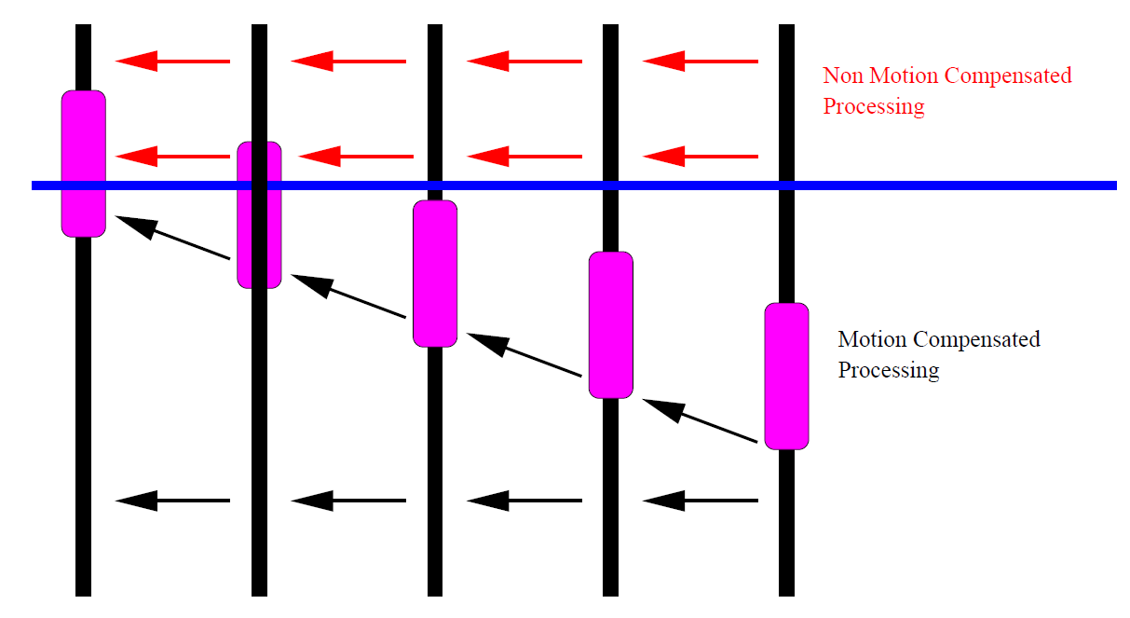
Motion Compensation or not?
Is the time taken to estimate motion vectors worth it?
Better quality but more computation

Slide 3
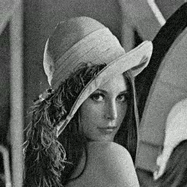
Noise Reduction in Video
How to remove noise without blurring the edges?

Slide 4
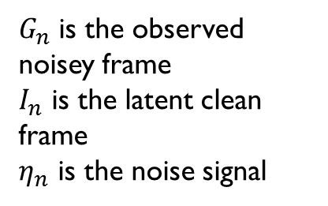
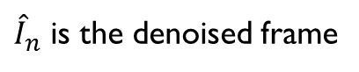
Noise Reduction in Video
Non-Motion compensated
Denoising via temporal averaging
Assuming no motion we can denoise by taking the average of all the preceding frames.
$G_{n}$ is the observed noisey frame
$I_{n}$ is the latent clean frame
$η_{n}$ is the noise signal
${\hat{I}}_{n}$ is the denoised frame

Slide 5
Noise Reduction in Video
Non-Motion compensated
Denoising via temporal averaging
No denoising of first frame
Average of first 2 frames
Average of first 3 frames

Slide 6
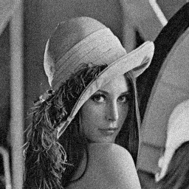

Noise Reduction in Video
First Denoised Frame
Second Denoised Frame

Slide 7

Noise Reduction in Video
10th Denoised Frame
Second Denoised Frame

Slide 8
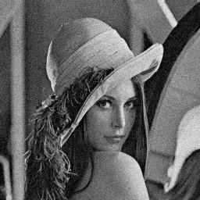
Noise Reduction in Video

Slide 9
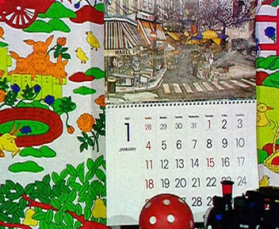

Noise Reduction in Video
But it doesn’t work well when motion is present

Slide 10

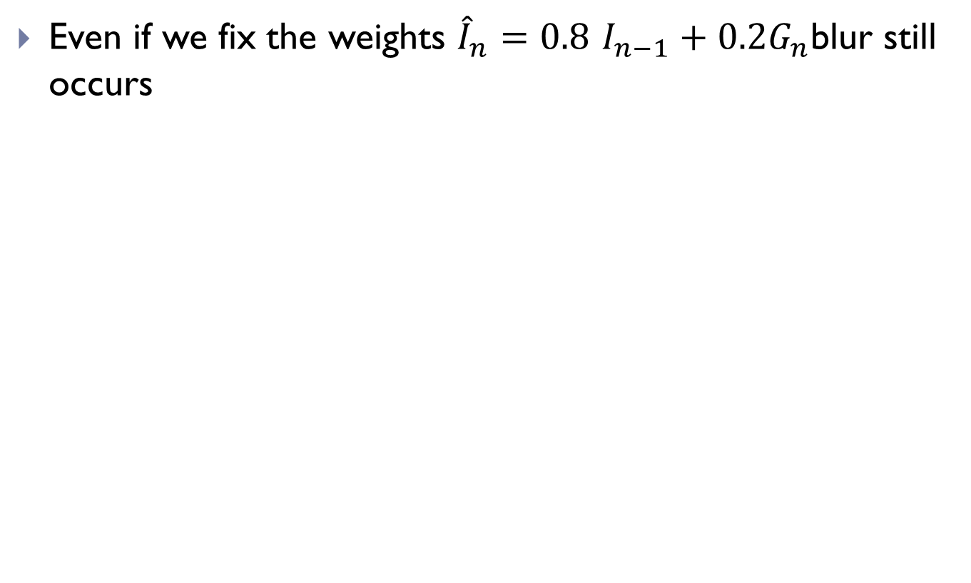
Noise Reduction in Video
Even if we fix the weights ${\hat{I}}_{n}=0.8$ $I_{n−1}+0.2G_{n}$blur still occurs

Slide 11
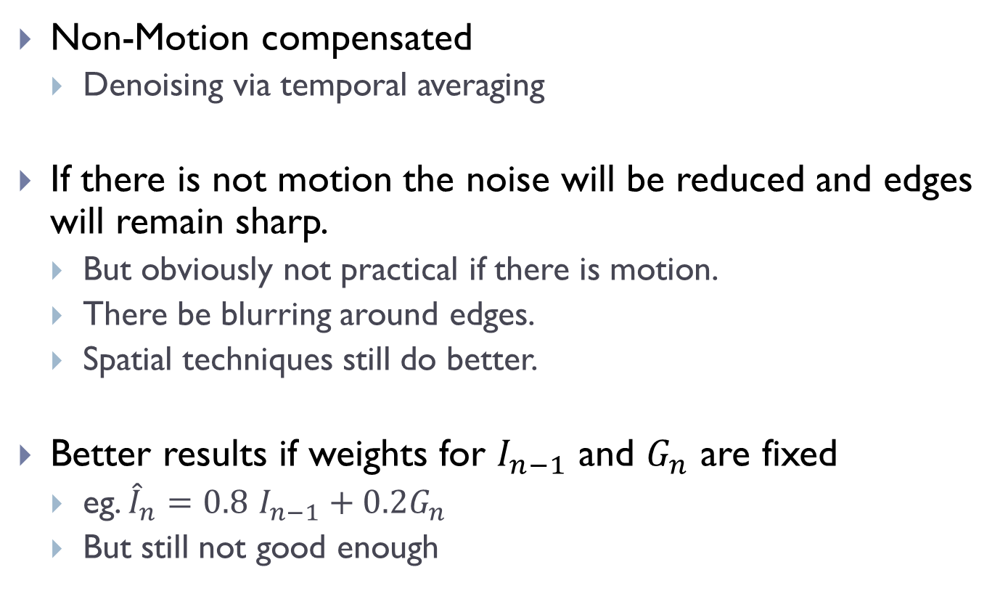
Noise Reduction in Video
Non-Motion compensated
Denoising via temporal averaging
If there is not motion the noise will be reduced and edges will remain sharp.
But obviously not practical if there is motion.
There be blurring around edges.
Spatial techniques still do better.
Better results if weights for $I_{n−1}$ and $G_{n}$ are fixed
eg. ${\hat{I}}_{n}=0.8$ $I_{n−1}+0.2G_{n}$
But still not good enough

Slide 12
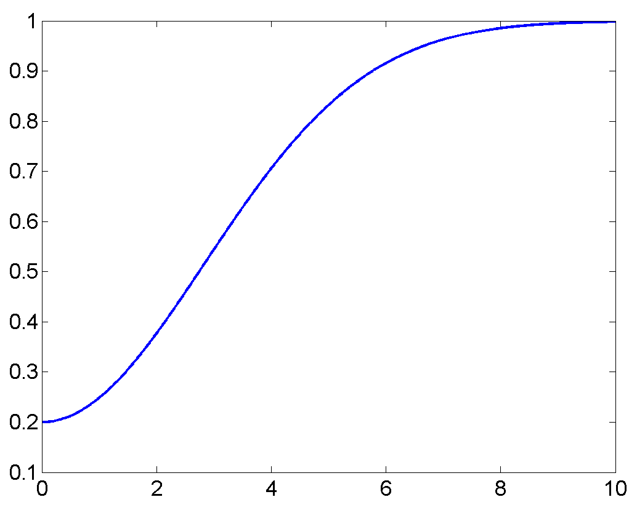
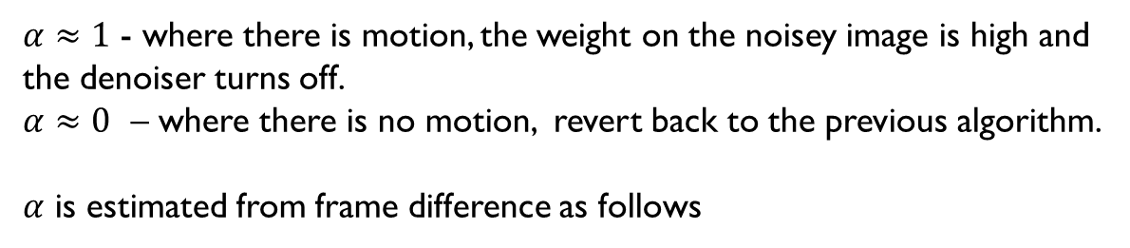
Noise Reduction in Video
Non-Motion compensated adaptive alpha
Integrate motion detection into the denoiser.
$α≈1$ - where there is motion, the weight on the noisey image is high and the denoiser turns off.
$α≈0$ – where there is no motion, revert back to the previous algorithm.
$α$ is estimated from frame difference as follows
eg. k₁=0.8, k₂ = 4

Slide 13
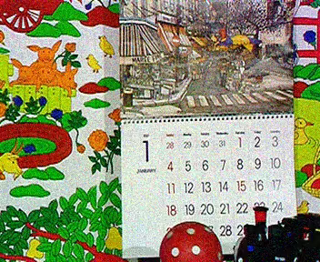
Noise Reduction in Video

Slide 14
Noise Reduction in Video
Non-Motion compensated adaptive alpha.
There is no blurring of moving regions but
moving regions are noisey
if an object starts to move then it will suddenly become noisey
Next option is to use motion compensation

Slide 15
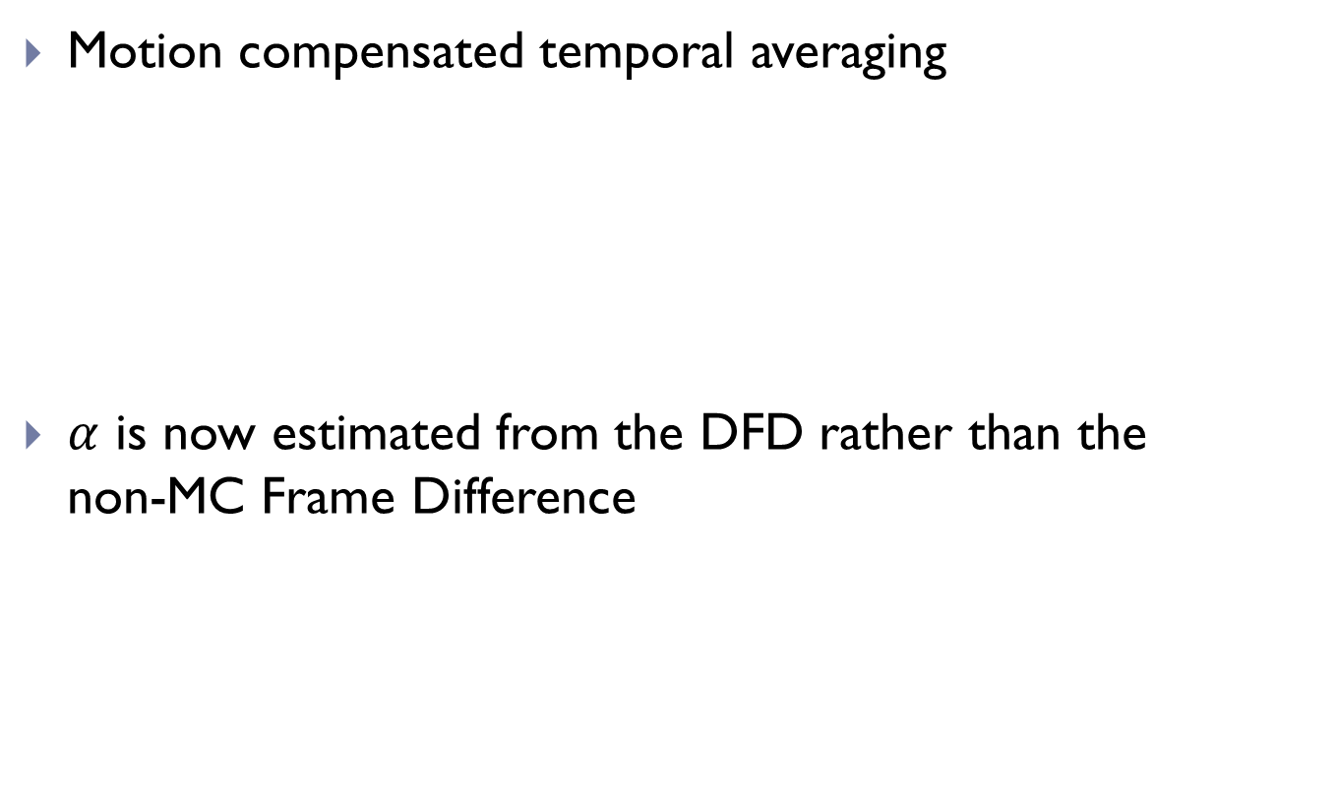
Noise Reduction in Video
Motion compensated temporal averaging
$α$ is now estimated from the DFD rather than the non-MC Frame Difference

Slide 16
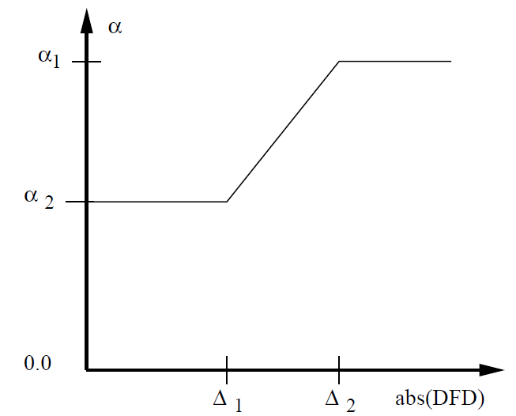
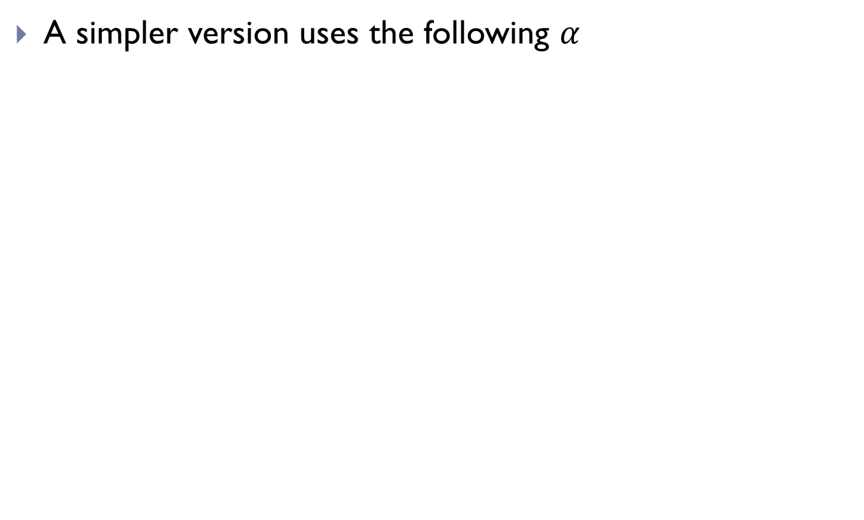
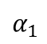
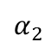
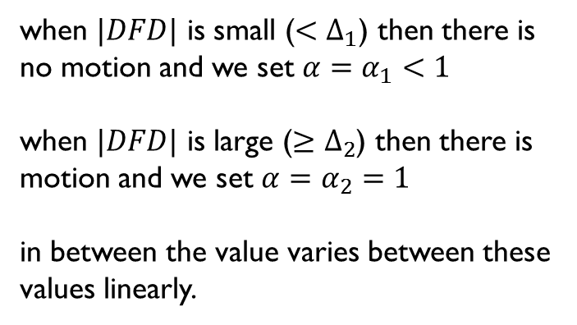
Noise Reduction in Video
A simpler version uses the following $α$
when $|DFD|$ is small ($<Δ_{1}$) then there is no motion and we set $α=α_{1}<1$
when $|DFD|$ is large ($≥Δ_{2}$) then there is motion and we set $α=α_{2}=1$
in between the value varies between these values linearly.
$$α_{2}$$
$$α_{1}$$
Correct Typos in Old Notes

Slide 17

Noise Reduction in Video

Slide 18
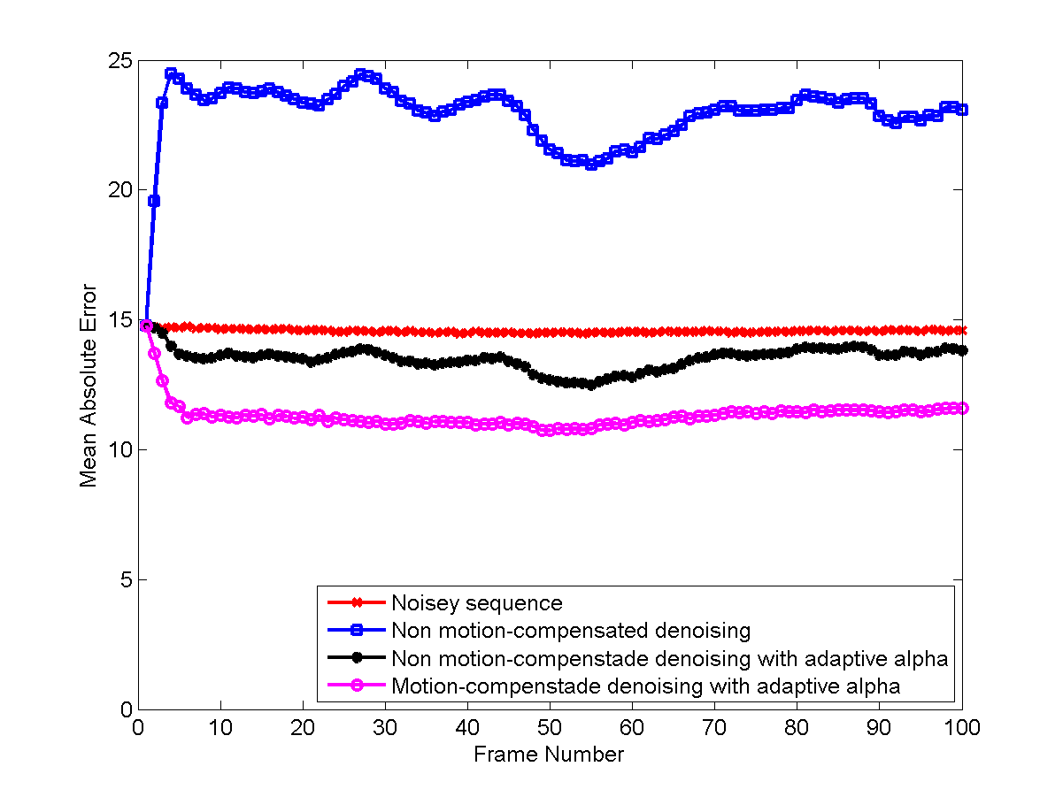
Comparing Denoise Algorithms
So you would choose whether to use the motion compensated or non-motion compensated versions depending on whether speed or quality was more important

Slide 19
Noise Reduction in Video
Unsurprisingly the best approach (for quality) is a combination of a spatial noise reducer and a temporal approach based around motion compensation.
This gives the best compromise between removing the dirty window effect and avoiding the blurring of spatial edges.
Many algorithms in existence based on these ideas.

Slide 20
Frame Rate Conversion
Non-motion compensated
Want to broadcast film material on TV say
different storage media has different frame rates
film – 24 frames per second
PAL/SECAM – 25 fps
NTSC – 30 fps
film is progressive but TV standards can be interlaced.
Film to PAL/SECAM
simply playback at 25 fps
movie will be 4% shorter on TV
Film to NTSC
3:2 pulldown (sometimes called 2:3 pulldown)

Slide 21
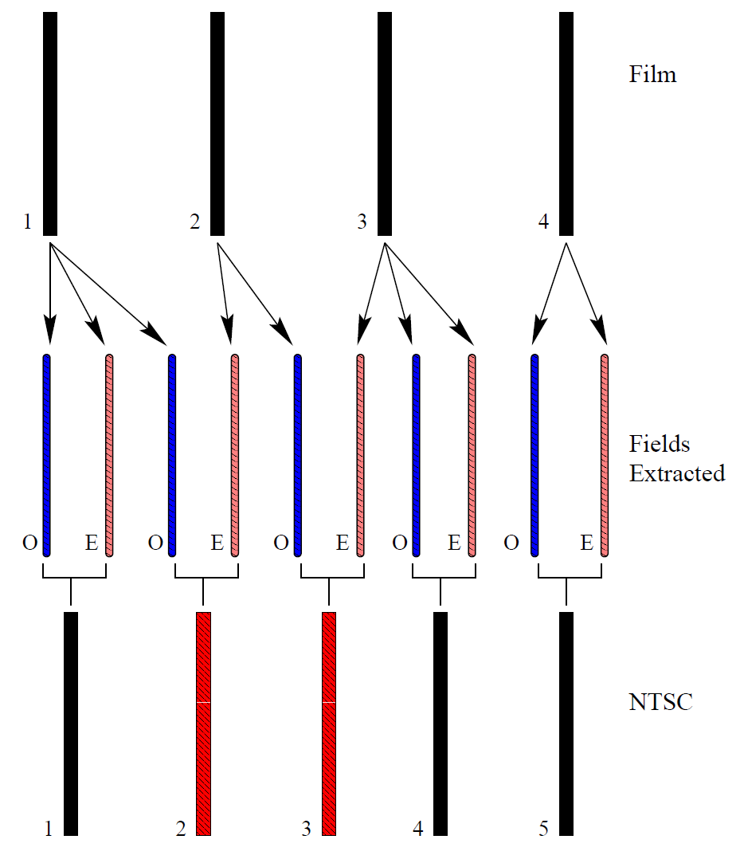
Frame Rate Conversion
3:2 pulldown
the name refers to the fact that 2 of the NTSC frames (2 and 3) are derived from 3 frames of film (1, 2 & 3).
Blurring artefacts possible if motion exists but people don’t notice.
Motion Compensation not necessary.

Slide 22
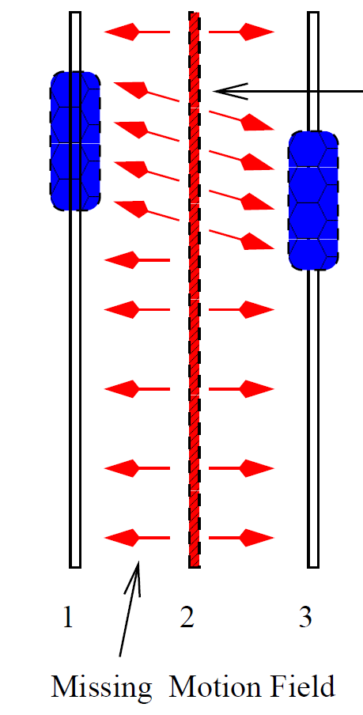
Frame Rate Conversion
Motion Compensated
Virtual Slow Motion
we want to increase the frame rate of the video (lets say double) but still play it back at 25 fps
Could just copy frames but motion will be jerky
assumption that there is 0 acceleration.
then the motion between frames 1 and 2 will be the same as between 2 and 3 but in opposite directions
missing frame

Slide 23
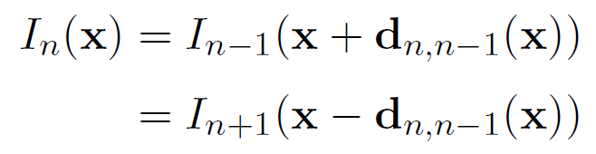
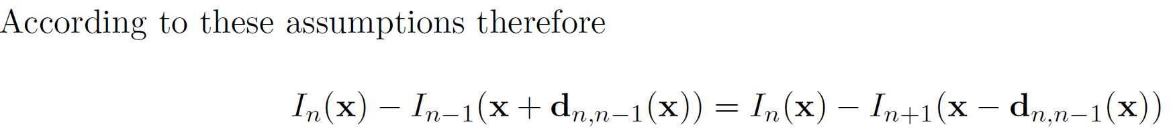
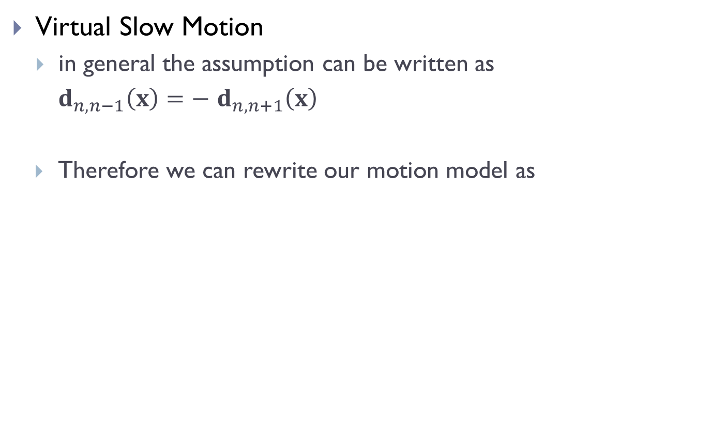
Frame Rate Conversion
Virtual Slow Motion
in general the assumption can be written as
$d_{n,n−1}\left(x\right)=−$ $d_{n,n+1}\left(x\right)$
Therefore we can rewrite our motion model as

Slide 24
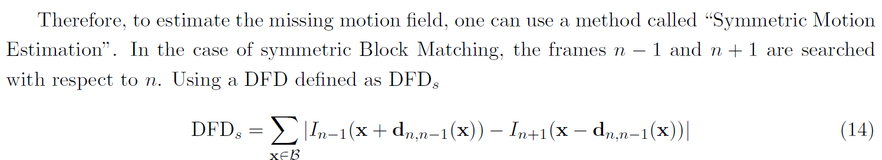
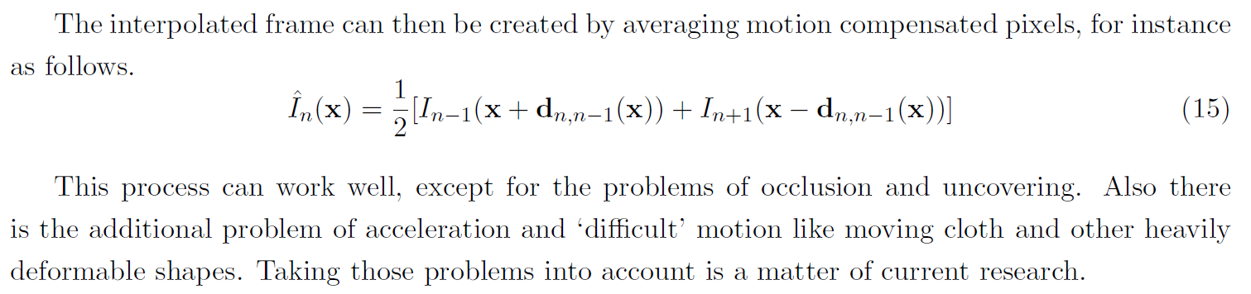
Frame Rate Conversion
We can then use block matching to find the vector $d_{n,n−1}\left(x\right)$ that minimises DFD_{s}.

Slide 25
Video Compression
Unlike Images Videos are almost never coded losslessly.
Consider a colour PAL sequence (720X576 at 25fps with 24-bit colour)
Data rate is 720x576x25x24 = 250 Mbps (approx)
ie. approx 223GB for a two hour movie (HD is at least 4 times more)
The bandwidth available for SD PAL transmission is between (3 to 6 Mbps) and a Blu-Ray disc holds up to 50GB
So high compression efficiency required (50 to 1 for SD TV)

Slide 26
A Brief History
Two major standards organisations define compression standards
ITU-T - H.26x
ISO – MPEG x
H.261 was the first widely used compression standard
finalised in 1988
design for video phone applications
low resolution (QCIF 176x144) transmission over an ISDN line (64 kb/s)
YC_{b}C_{r} colourspace using 4:2:0 subsampling (88x72 C_{b} and C_{r} values in total)

Slide 27
A Brief History
MPEG 1– (Moving Picture Experts Group)
designed for CD-ROM applications (VCD)
to compress VHS quality video (PAL or NTSC) at bit rates as low has 1.5 Mbps
a capacity of a CD-ROM is about 700MB – enough for about 1 hour of video at 1.5 Mbps
better known now for its audio standard MPEG-1 part 3 (ie. mp3)
MPEG 2 / H.262 (mid 90s)
designed for digital SD TV
PAL (720x576) or NTSC (720x480) at 4 to 10 Mbps
supports interlaced videos, different aspect ratios (16:9 and 4:3) + frame rates
also used for DVD (about 9 Mbps) & HDTV (15 to 20 Mbps)

Slide 28
A Brief History
H.263
designed to supersede H.261 but also supports higher resolutions.
it achieves equivalent quality with lower bit rates.
very popular format for web as it could be used to transmit video over dial-up modems (ie. 28 kpbs / 56 kbps)
used in flash video (ie. the dominant format on the web)
MPEG 4 (part 2)
based on H.263
designed for all resolutions and bit rates
Some DivX and Xvid codecs use this format but it is not widely used because of…

Slide 29
A Brief History
MPEG 4 (part 10) / H.264 / MPEG 4 AVC
initially designed to achieve lower bit rates than MPEG 2 and H.263 (50 % reduction in most cases)
being adopted for use in digital TV (Saorview and Freeview HD)
has increased error resilience so is suitable for use on mobiles
VPx Codecs
Aims to avoid use of patented technologies
Developed by ON2, acquired by Google in 2010
Video Compression and 4C8
we will cover the fundamental concepts in video compression (ie. the use of motion compensation)
we will also look at the MPEG 2 standard as a case study.

Slide 30
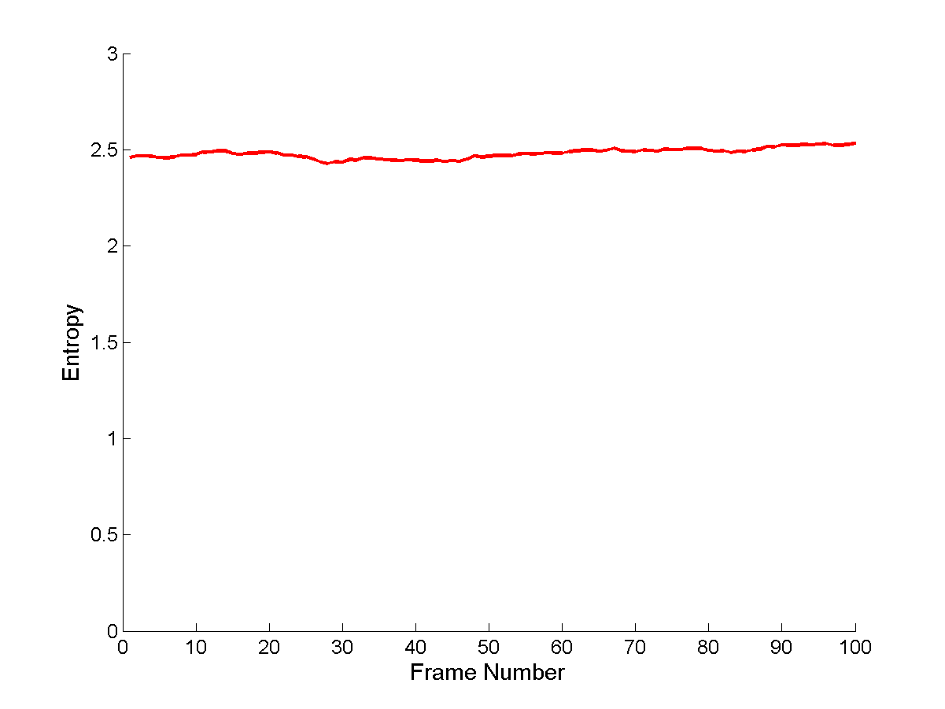
Video Compression
Non-motion compensated
JPEG on every frame – motion JPEG
This is not an optimal solution as temporal redundancy is ignored.
The graph shows the DCT Entropies of the first 100 frames of the mobcal sequence.
The Q_{step}=15 for all bands

Slide 31

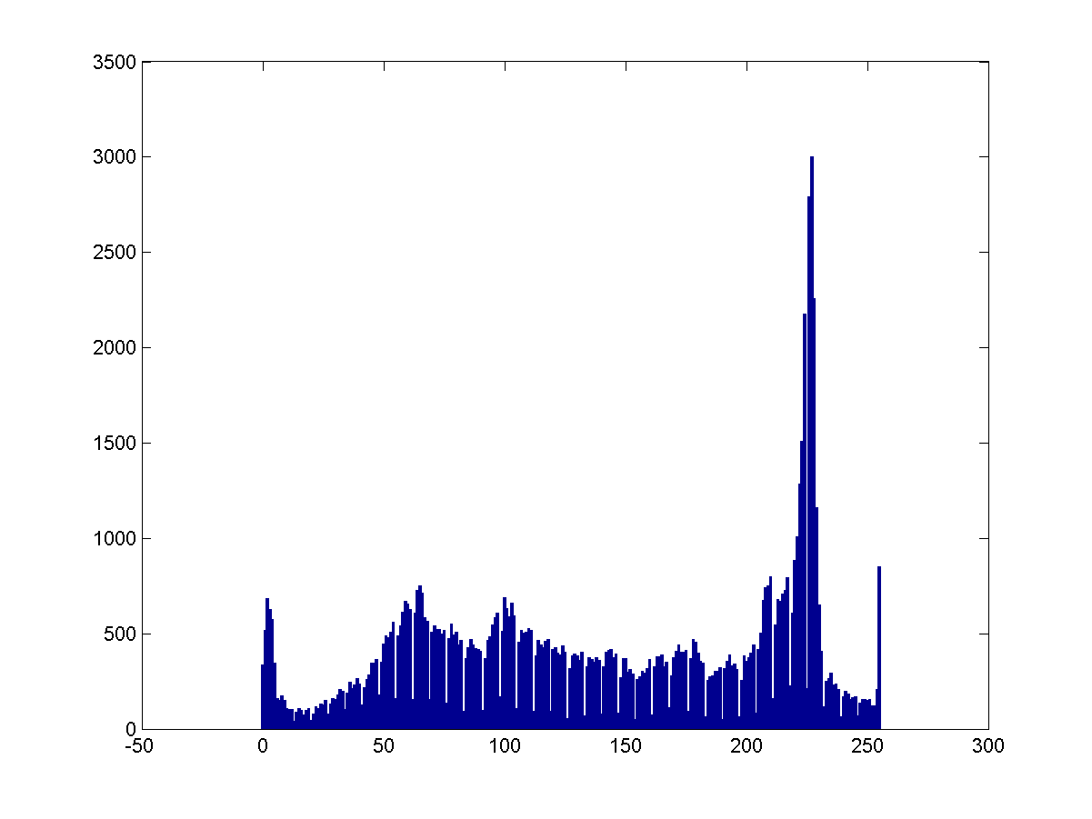
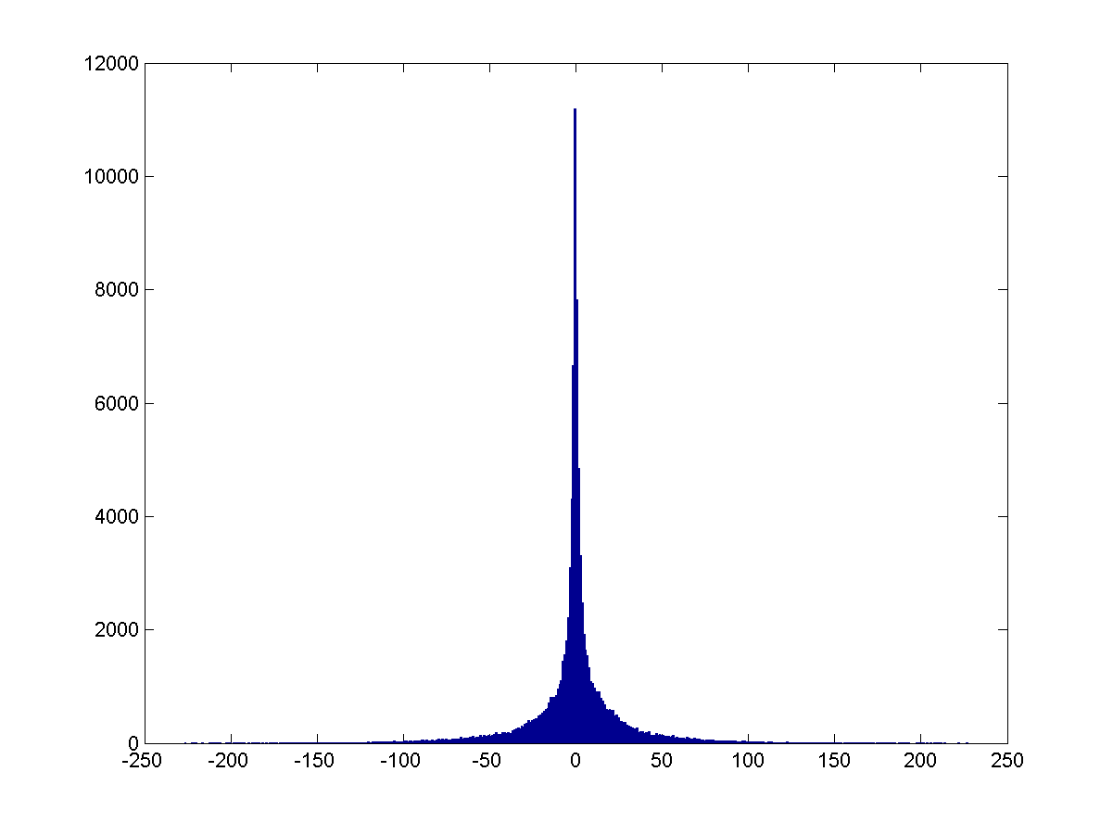
Video Compression
Non Motion Compensated
JPEG First Frame – then JPEG frame difference for subsequent frames
The frame itself has an entropy of approx 7.6 bits/pel
The entropy of the frame difference is approx 6.1 bits/pel

Slide 32
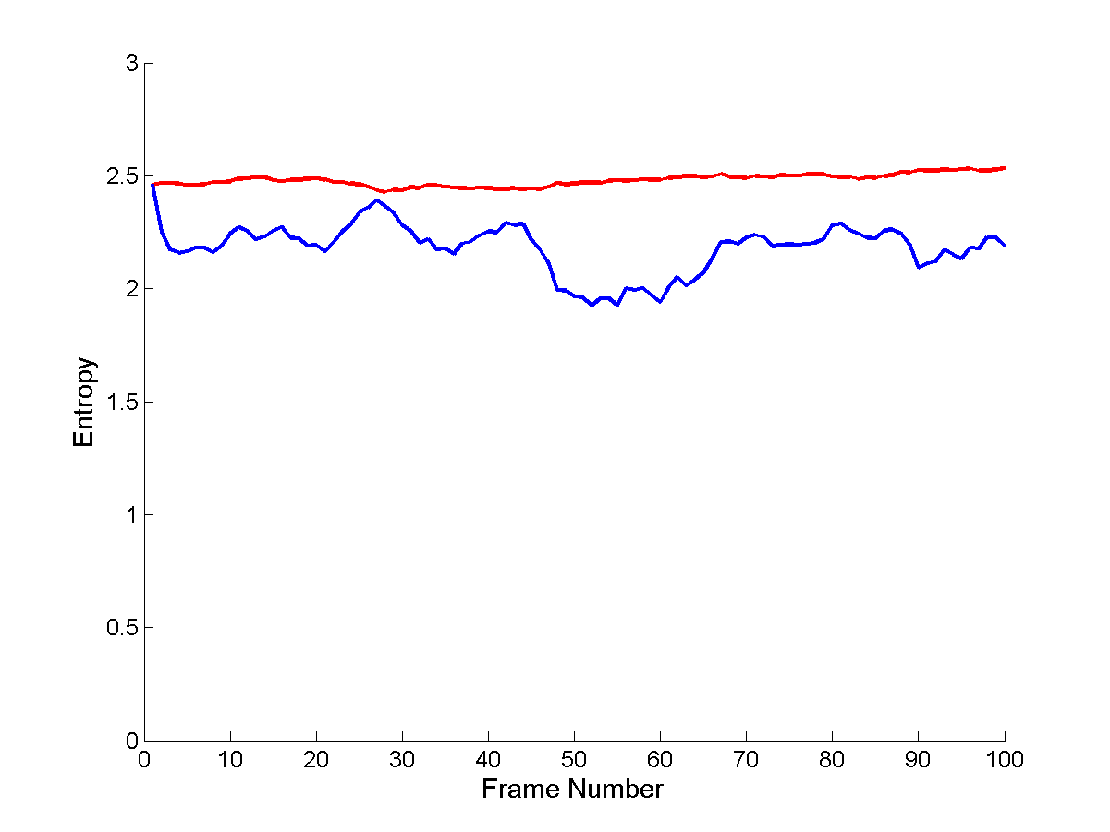
Video Compression
Non-Motion Compensated
JPEG first frame and then JPEG frame difference
When the DCT is applied to the frame difference over the first 100 frames of the mob_cal sequence the blue plot is obtained.
The entropy for the first frame is the same as there is no frame difference available.

Slide 33

Video Compression
Motion Compensated
JPEG first frame and then JPEG DFDs
Histogram of Frame Difference
Due to motion estimation, the DFD has a lower mean absolute value and so the histogram has higher values around 0 and hence its entropy is reduced from 6.1 bits/pel to 5.6 bits/pel
Histogram of Displaced Frame Difference

Slide 34
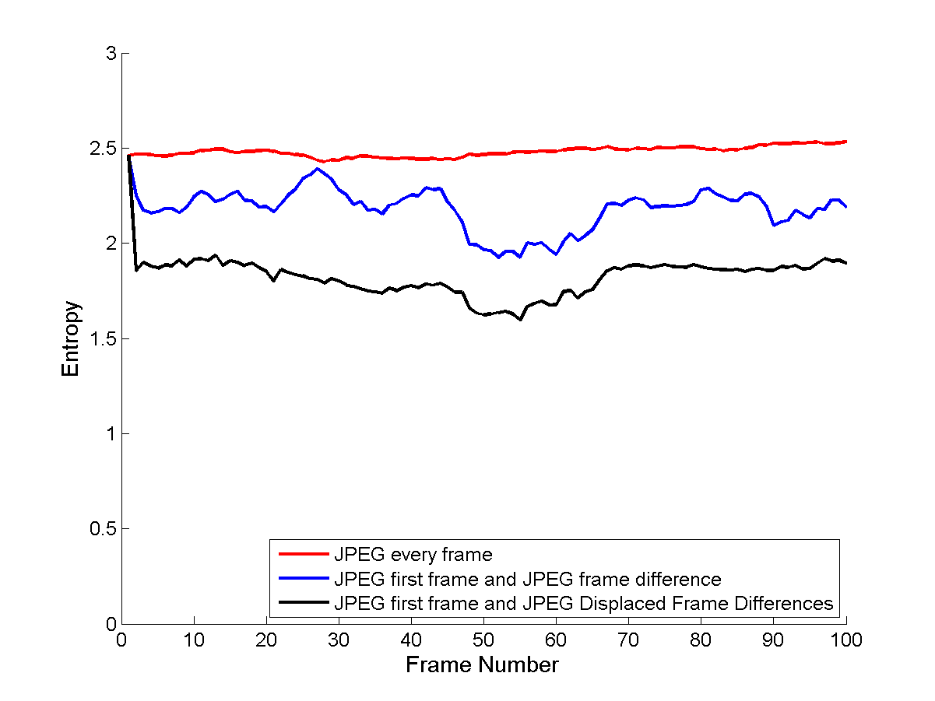
Video Compression
Motion Compensated
JPEG first frame and then JPEG DFDs

Slide 35
Video Compression
Need to exploit temporal redundancy to get better compression
Encoding motion compensated DFD gives best efficiency.
but we also have to encode the motion vectors.
This does not add too much of a penalty to the bit rate
Video Compression standards are based on these ideas
The first JPEG coded frame is referred to as an Intra-Coded Frame (I frame)
The JPEG coded DFDs are called Prediction Frames (P-frames)

Slide 36
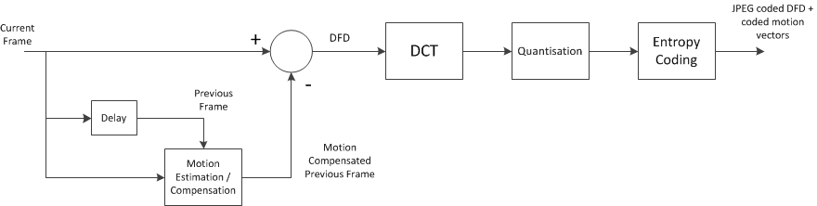
Video Compression
Block Diagrams for encoding P-Frames
This is the block diagram is implemented to get the black graph on the last page.
Encoding of the I-frame uses the same procedure as JPEG
The motion estimation and compensation is performed in series with the JPEG compression.
This is however is a overly-simplistic model for the encoder.

Slide 37
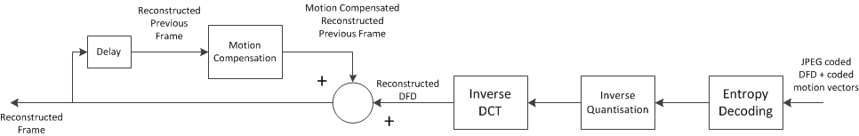
Video Compression
Block Diagrams for encoding P-Frames
Decoding of the I-frame uses the same procedure as JPEG
The first stage estimates the Reconstructed (Decoded) DFD. In the second step add this to the motion compensated previous frame.
If the current frame is the first frame after the I-frame, the motion compensated previous frame is estimated from the decoded I-frame. Otherwise, it’s estimated the previous output as indicated in the diagram.

Slide 38
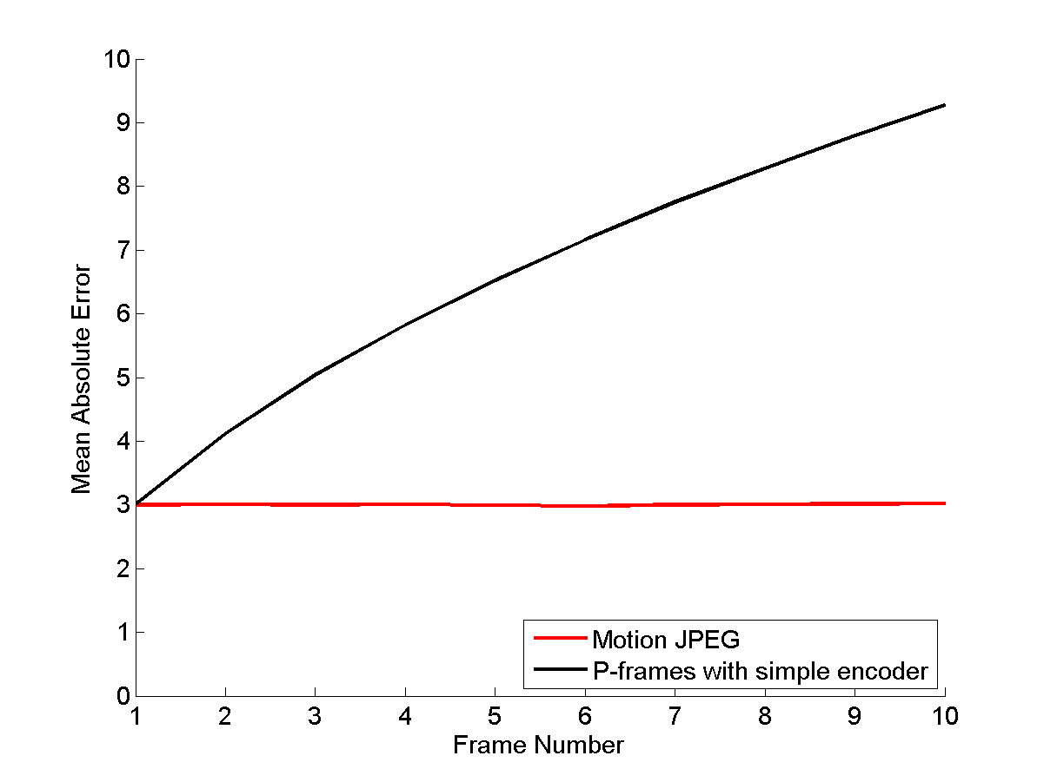
A Problem with the Encoder
Lets compare the MAE between the original and reconstructed image if we use this encoder.
Errors accumulate in the reconstructed Image and the MAE steadily increases.

Slide 39
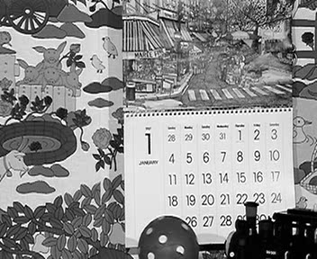

A Problem with the Encoder
Lets compare the 10th reconstructed frame with the motion JPEG frame.
Motion JPEG
Simple Encoder

Slide 40
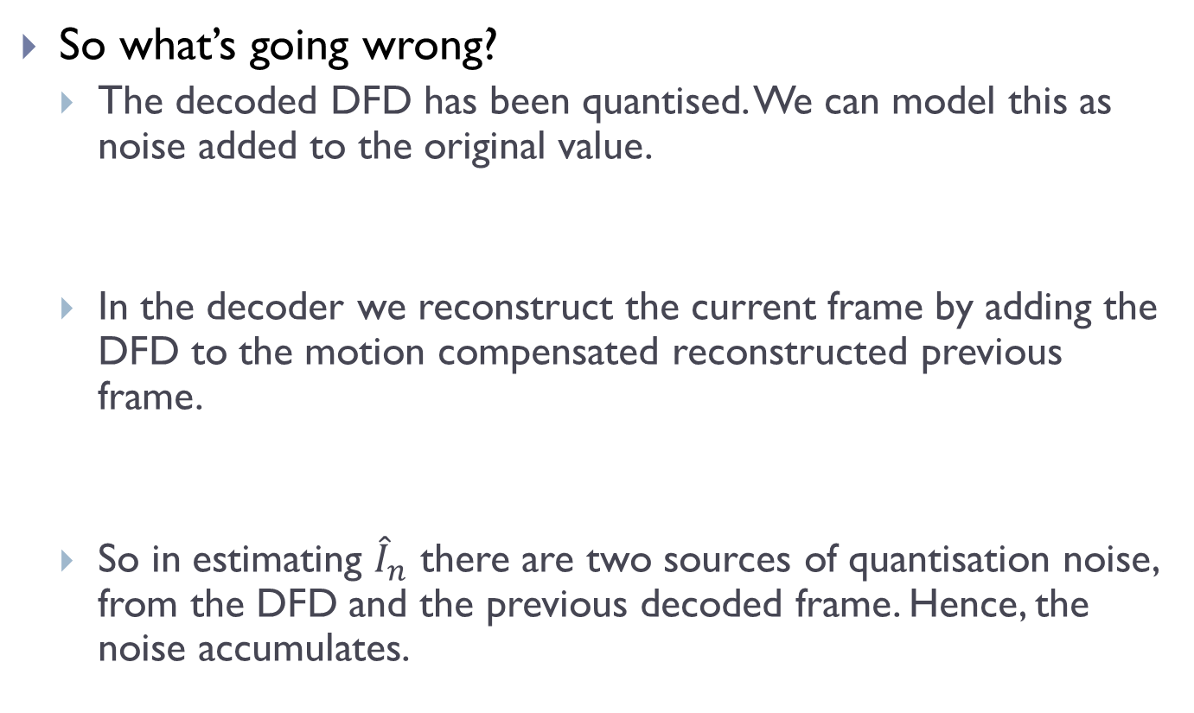
A Problem with the Encoder
So what’s going wrong?
The decoded DFD has been quantised. We can model this as noise added to the original value.
In the decoder we reconstruct the current frame by adding the DFD to the motion compensated reconstructed previous frame.
So in estimating ${\hat{I}}_{n}$ there are two sources of quantisation noise, from the DFD and the previous decoded frame. Hence, the noise accumulates.

Slide 41
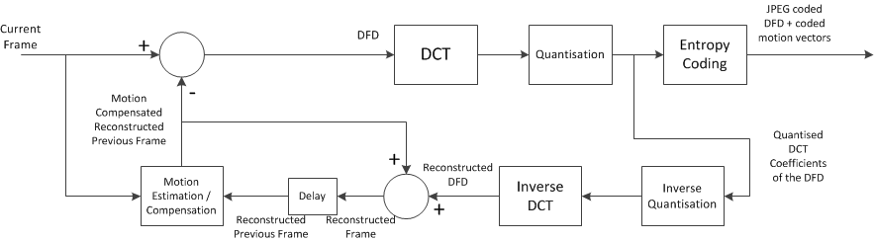
An Encoder using Feedback
The solution is to estimate the motion in the encoder between the current frame and decoded previous frame. Some of the decoder stages are placed in the encoder.
This allows the quantisation effect to be captured in the motion estimation process and so the DFD contains an additive signal that approximately corrects the noise.
When the DFD is subsequently decoded the quantisation noise will be offset by the correction signal in the DFD.

Slide 42
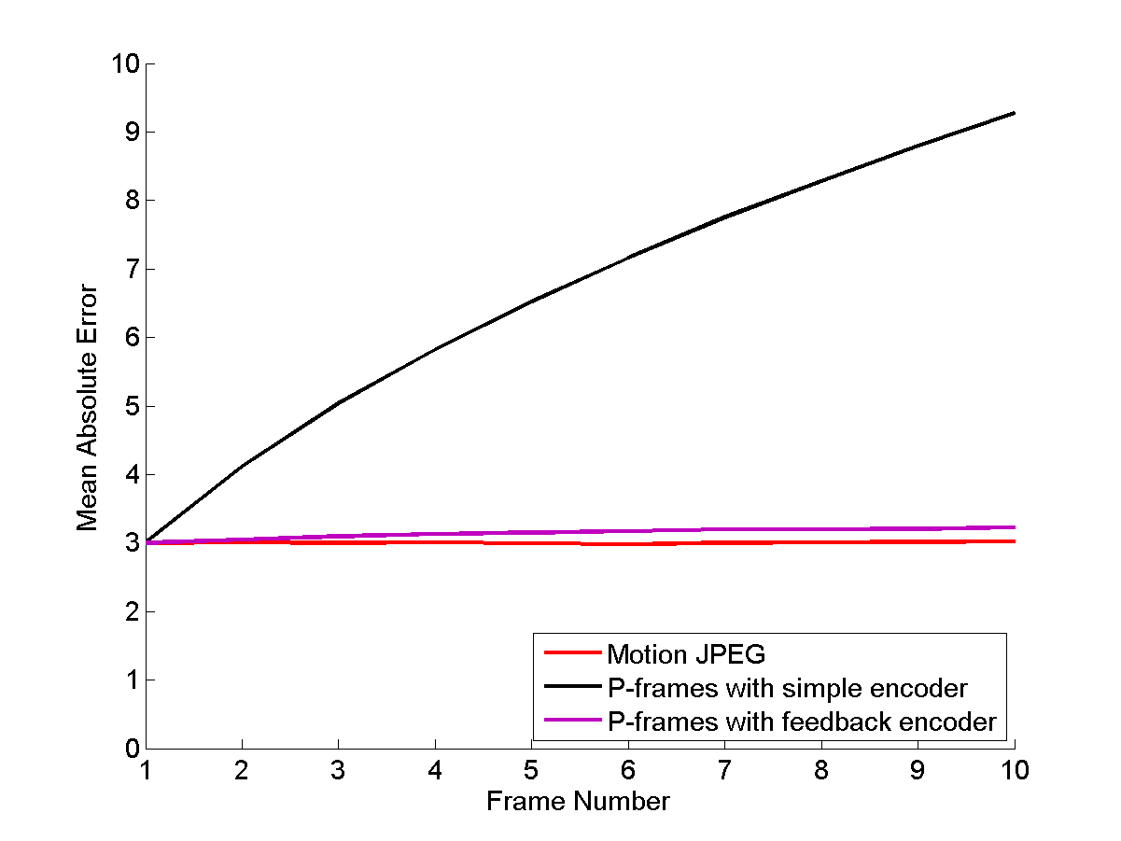
Using the Encoder with Freedback
Lets compare the MAE between the original and reconstructed image if we use this encoder.
The Error increases only slightly over the motion JPEG frames.

Slide 43

Using the Controller with Feedback
Lets compare Frame 10 again
Simple Encoder
Feedback Encoder

Slide 44
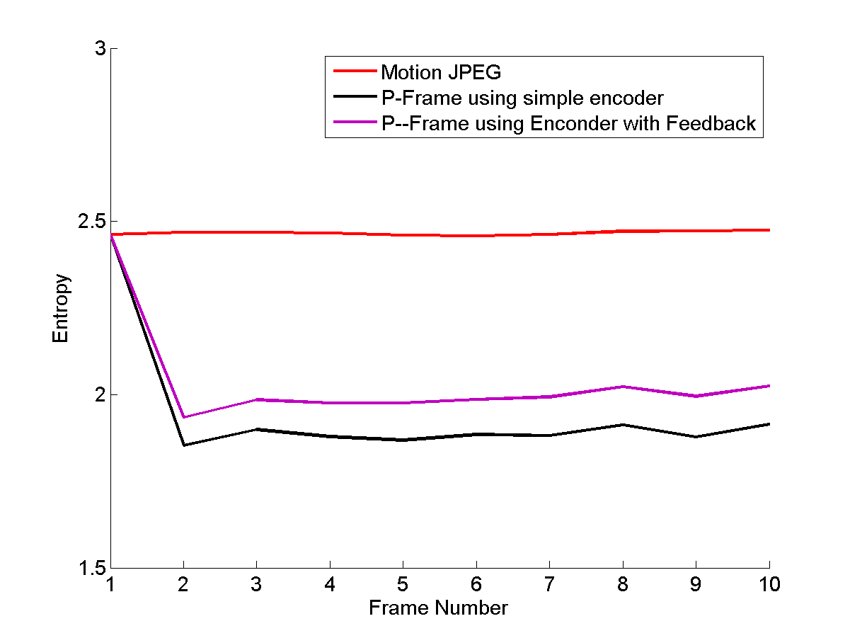
Using the Controller with Feedback
But there is a cost
There is a slight entropy penalty with the feedback controller. This is due to the extra correction signal in the DFD.
Note: This implementation is primitive. With more sophisticated processing it should be possible to mitigate the increase in entropy as well as decrease the MAE further.

Slide 45
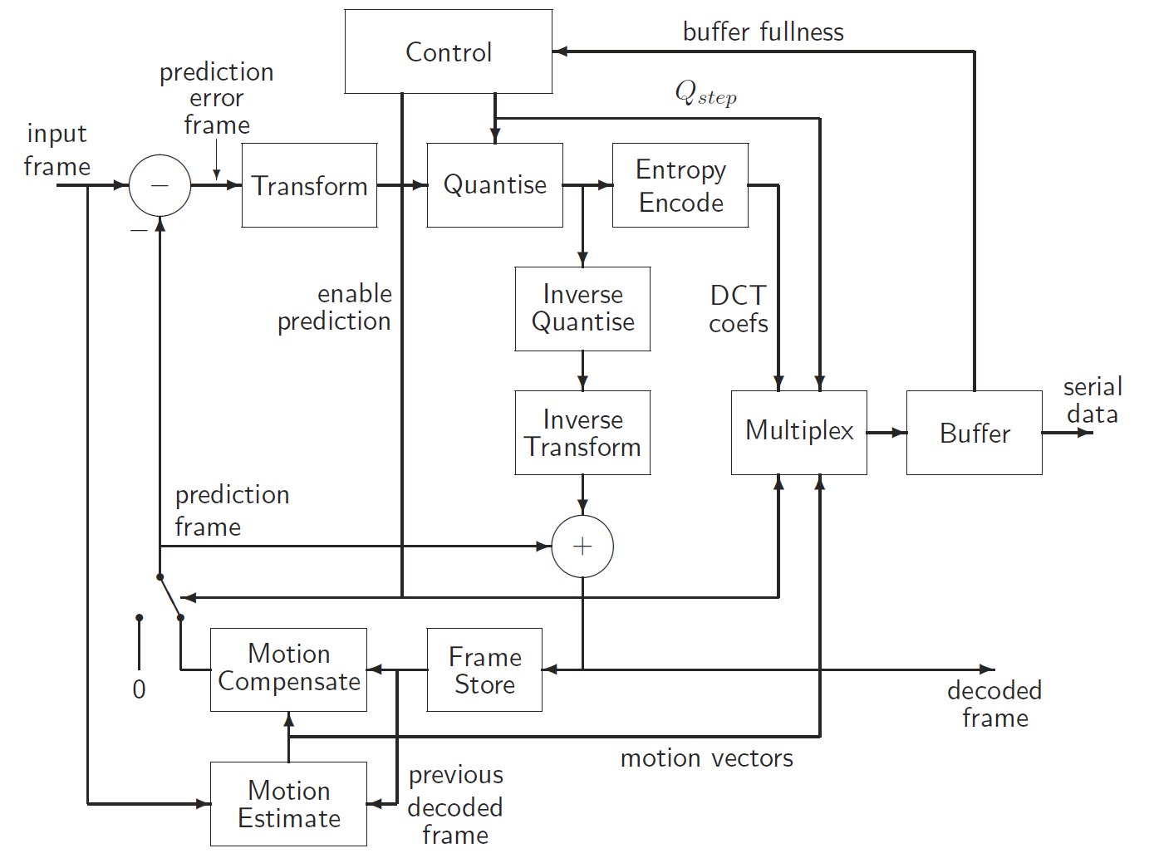
Motion Compensated Prediction Coding (used in H.261)

Slide 46
A Further Note on MCPC
In H.261 an I-frame is followed by a series of P-frames
IPPPPPPP……
In H.261 and other systems a new I frame will be inserted periodically into the sequence
eg. IPPPPPPPPPIPPPPPPPPPIPP……
ie. every 10th frame is intra-coded JPEG like frame and the rest use MCPC based on the previous frame in the sequence.
This limits propagation of prediction errors in the compressed stream.
The period between I-frames is called a Group-Of-Pictures (GOP)
The structure of the GOP in the above example is IPPPPPPPPP
The size of the GOP is 10 frames (it could be different)

Slide 47
A Further Note on MCPC
MCPC typically uses a 16 x 16 block size for motion estimation.
This is different from the 8 x 8 block size typically used for the DCT.
Due to the different sizes the 16 x16 blocks are referred to as macroblocks
the 8x8 DCT blocks are simply referred to as blocks
Each macroblock contains a 2x2 grid of blocks as well as a single motion vector

Slide 48
Bi-Directional Prediction
More recent standards use a strategy called bi-directional prediction
X
Z
Data only available from earlier frame (X)
Date only available from later frame (Z)
Y

Slide 49
Motion Compensated Video Compression
Why do we care?
if data does not exist in previous frames then the prediction error (ie. the DFD) will be large.
hence there is an increase in its entropy.
Solution
for every macroblock look forward and backward to see which direction gives the lowest mean absolute prediction error. That is chosen as the direction for prediction.
Hence each macroblock also contains information about which direction should be used to perform motion.
Frames Encoded in this manner are referred to as B-frames.

Slide 50
Bi-Directional Prediction – GOP structure
In MPEG 2 two B frames are inserted between each I or P frame.
ie. IBBPBBPBBPBBI
The length of a GOP is usually a multiple of 3 (12 or 15 is common for MPEG2)
The first frame is intra-coded.
The fourth frame uses normal prediction coding. It is predicted relative to the I-frame. ie. Motion is estimated between frame 4 and frame 1.
Motion Vectors between frame 1 and frame 4.
They are also sent in the stream
The Prediction Error that is coded

Slide 51
Bi-Directional Prediction – GOP structure
12 frame GOP - IBBPBBPBBPBBI
Frames 2 and 3 are B-Frames
The frame used for backward prediction is frame 1 (I-frame).
The frame for forward prediction is the frame 4 (P-frame).
So for frame 2
Motion between frame 1 and 2
Backward Prediction Error
Forward Prediction Error
Motion between frame 4 and 2

Slide 52
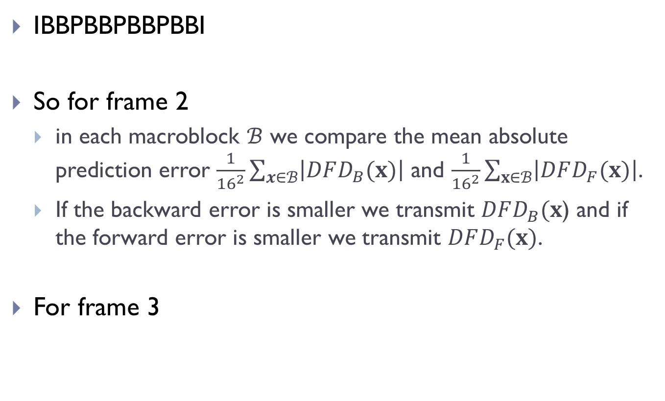
Bi-Directional Prediction – GOP structure
IBBPBBPBBPBBI
So for frame 2
in each macroblock $ℬ$ we compare the mean absolute prediction error $\frac{1}{{16}^{2}}\sum_{x∈ℬ}{\left|DFD_{B}(x)\right|}$ and $\frac{1}{{16}^{2}}\sum_{x∈ℬ}{\left|DFD_{F}(x)\right|}$.
If the backward error is smaller we transmit $DFD_{B}(x$) and if the forward error is smaller we transmit $DFD_{F}(x)$.
For frame 3

Slide 53
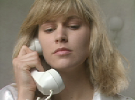
Example

Slide 54
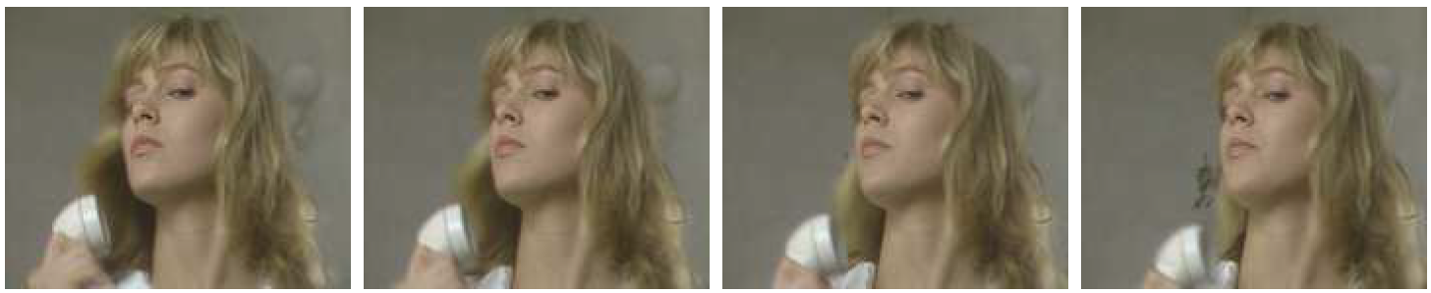
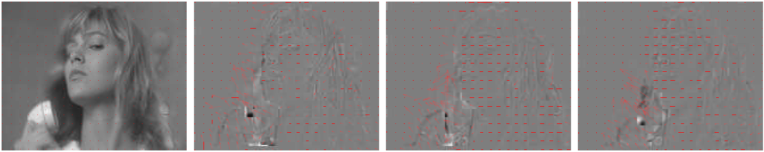
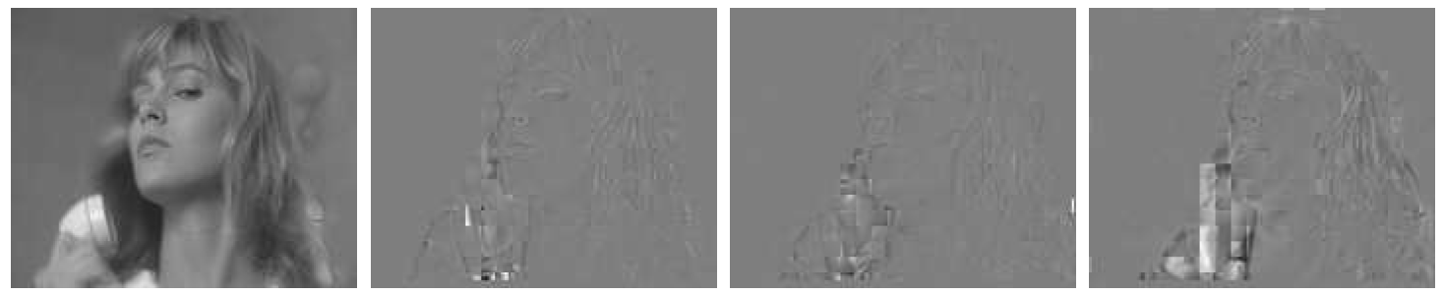
Frame 1
Frame 2
Frame 3
Frame 4
I - frame
P - frame
P - frame
P - frame
I - frame
B - frame
B - frame
P - frame

Slide 55
Bi-Directional Prediction – GOP structure
The rest of the GOP is coded in a similar manner
The 2nd P-frame (frame 7) is predicted from frame 4
B-frames 5 and 6 use frame 4 for backward prediction and frame 7 for forward prediction.
This pattern repeats for the rest of the frames in the GOP.
The last 2 B-frames use the I-frame of the next GOP for forward prediction.

Slide 56
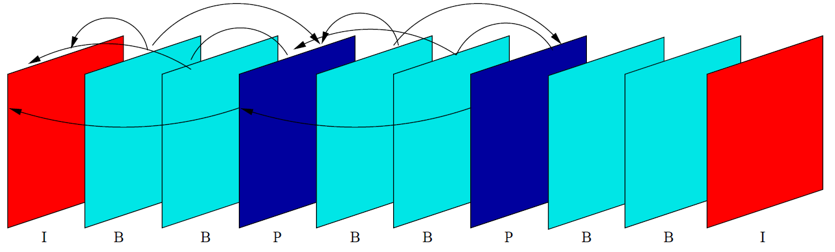
GOP Prediction Pattern (MPEG 2)
This is a handy graphic that illustrates the prediction directions over a GOP
Due to the pattern of a GOP its length is usually a multiple of 3
possible lengths depend on the standard.

Slide 57
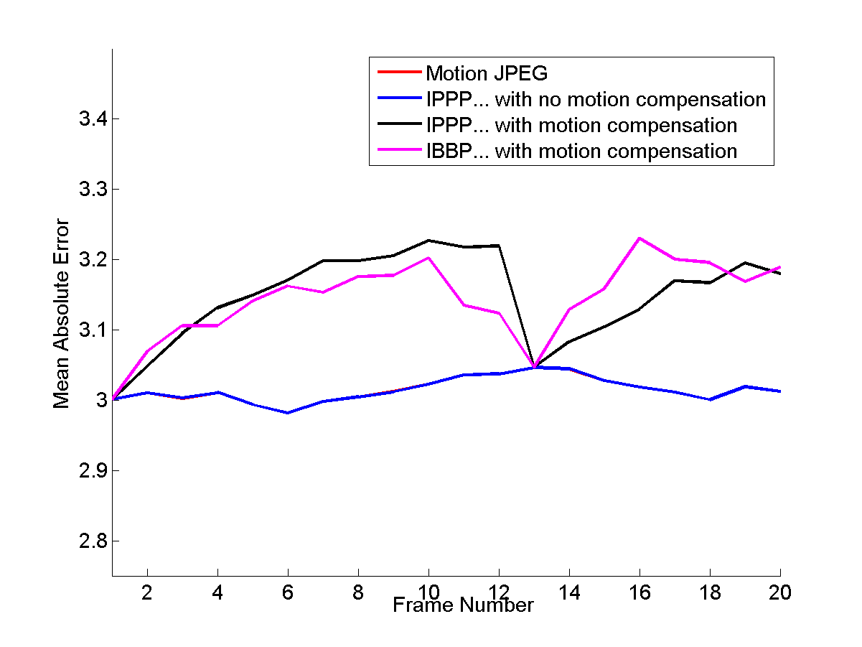
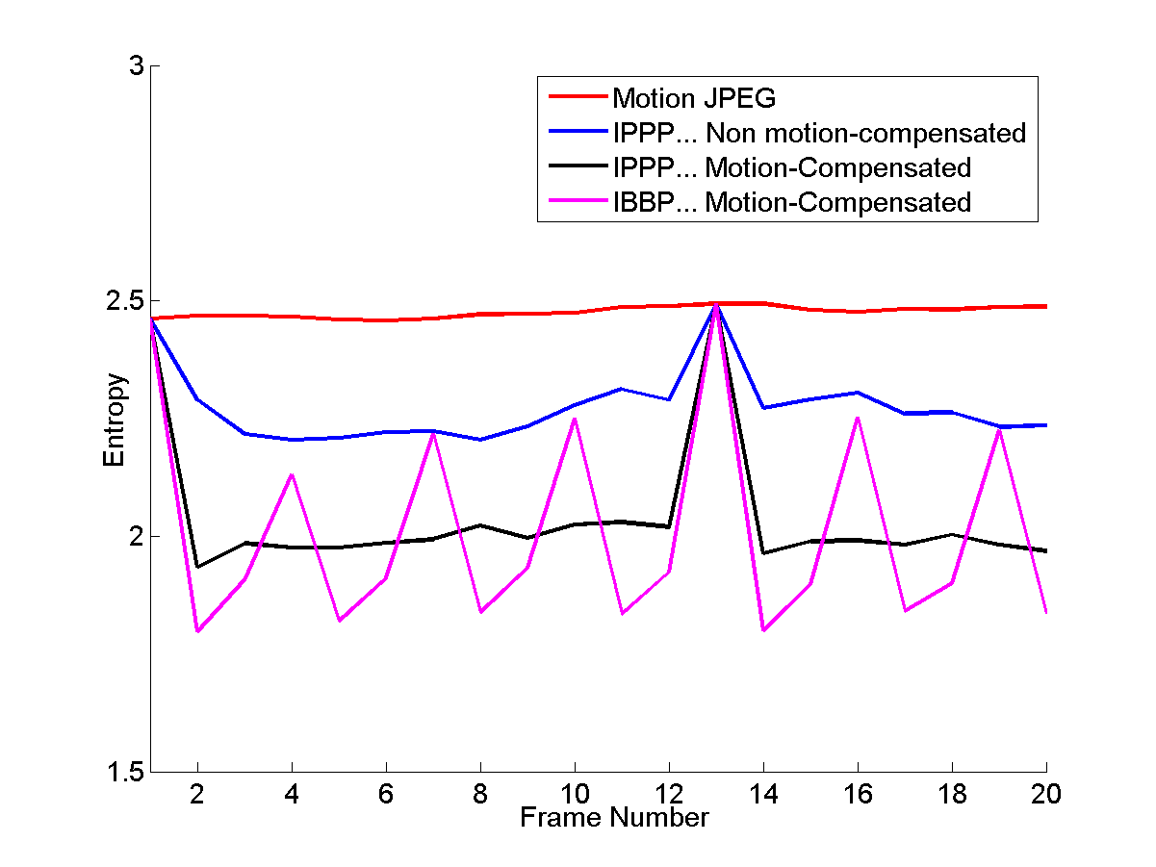
Analysis of Bi-Directional Prediction
Entropy and Mean Absolute Error Plots for the first 20 frames of the mobile and calendar sequence

